Slide 1
Evidence for Evolution: Pattern
Motivation
How does evolution explain historical and contemporary patterns of biological diversity??
Notes:
Evolution explains a lot about the pattern of diversity we see, organisms, diseases etc.

Slide 2
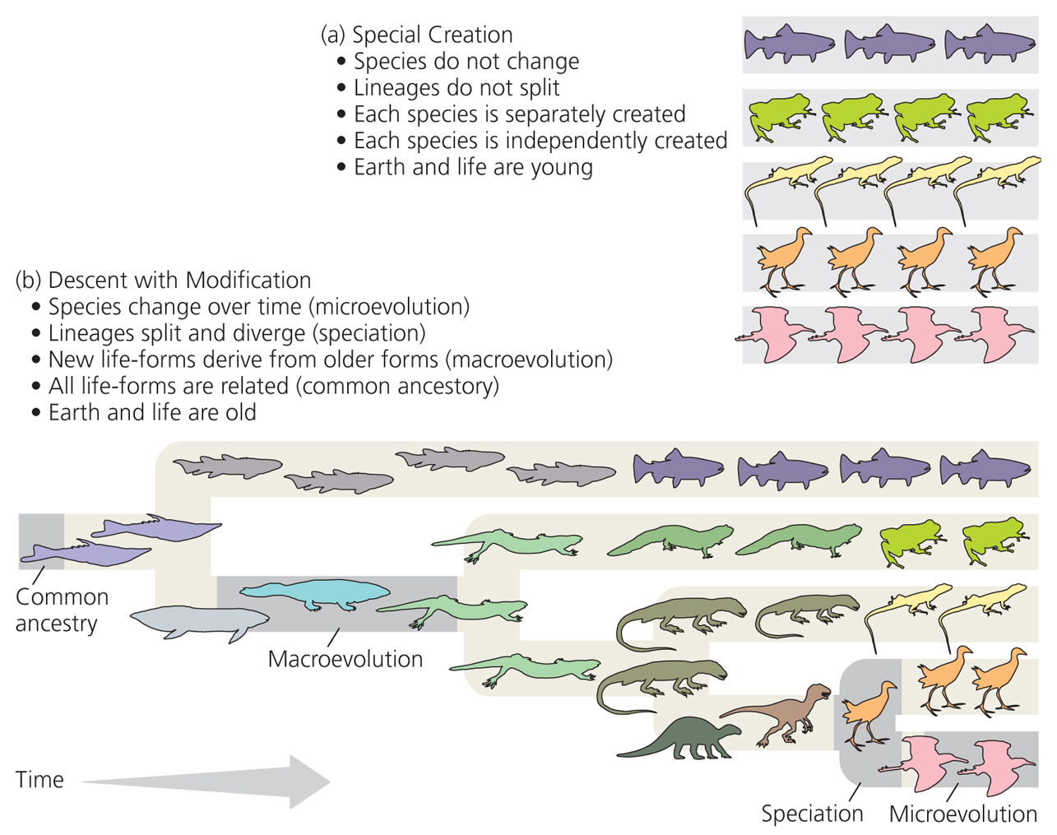
II. Descent with Modification
Notes:
Figure 2.1 Two views of the history of life
Bishop Usher, other views as well
These cartoons illustrate the contrasting claims made by the Theory of Special Creation versus the Theory of Descent with Modification.
Focus on Descent with Modification in the following figures
add talk about humans

Slide 3
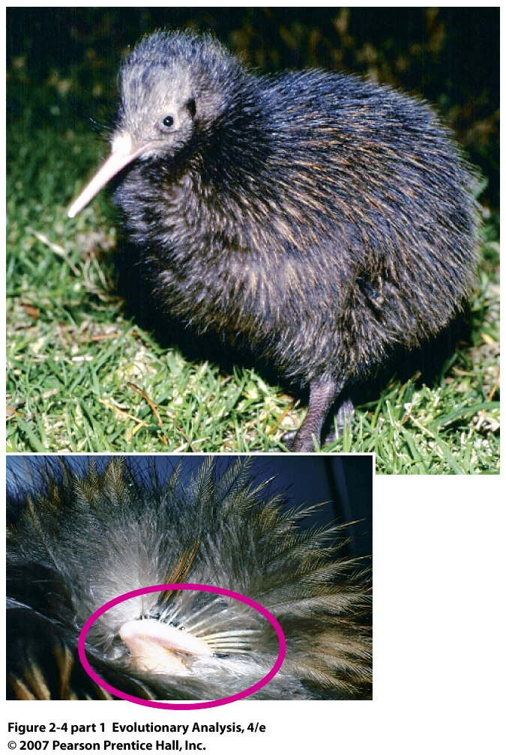
III. Evidence of
Change Over
Time
A. Vestigial Traits
A useless or rudimentary version of a body part that has an important function in
other closely related species
Notes:
Figure 2.4 (part 1) Vestigial structural traits
The brown kiwi, a flightless bird, has tiny, useless wings.

Slide 4
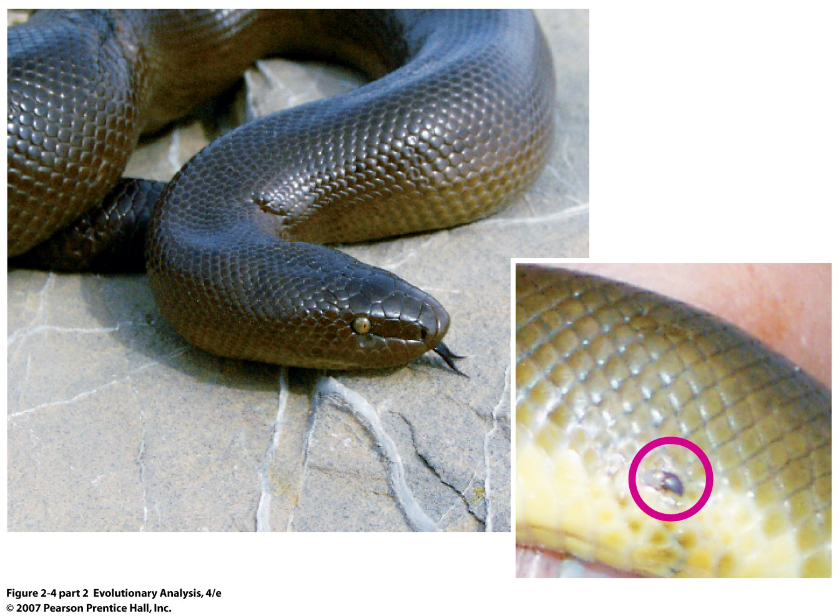
Rubber boa has tiny
remnant of hind limb
Notes:
Figure 2.4 (part 2) Vestigial structural traits
The rubber boa has a tiny remnant hind limb, called a spur, on either side of its vent.

Slide 5
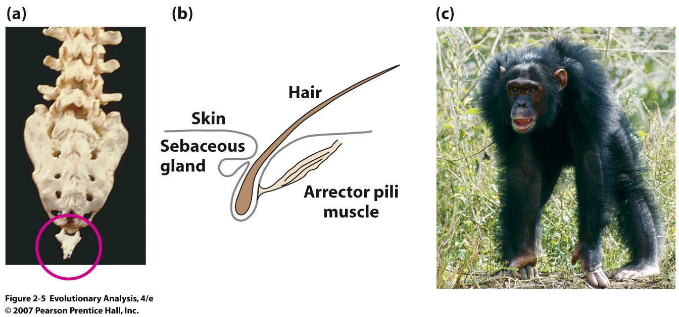
Humans: vestigial tailbone goosebumps are remnant
of erecting hair
Notes:
Figure 2.5 Human vestigial traits
(a) Humans have a rudimentary tailbone, called the coccyx. (b) Humans have a muscle, the arrector pili, at the base of each hair follicle. When it contracts, producing a goosebump, the hair stands up. (c) If we were hairy, like this chimpanzee, then contraction of our arrector pili muscles would increase the loft of our fur to keep us warm, or to make us look more intimidating.

Slide 6
Enzyme:Putative cytidine monophosphate-N-acetylneuraminic acid
hydroxylase-like protein
In Humans coded by CMAH locus
-- Two most common forms of sialic acid found in mammalian cells are
N-acetylneuraminic acid (Neu5Ac) and its hydroxylated derivative,
N-glycolylneuraminic acid (Neu5Gc).
-- Neu5Gc not detectable in human tissues although abundant in other mammals.
-- Absence of Neu5Gc in humans is due to a 92-base pair deletion
CMAH encoding cytidine monophosphate-N-acetylneuraminic acid
hydroxylase, an enzyme responsible for Neu5Gc biosynthesis
-- Homologous sequence from mouse, pig and chimpanzee does not have deletion
-- Deletion occurred about 3.2 million years ago, some 3 million years after split of
human lineage from chimps
http://en.wikipedia.org/wiki/CMAH

Slide 7
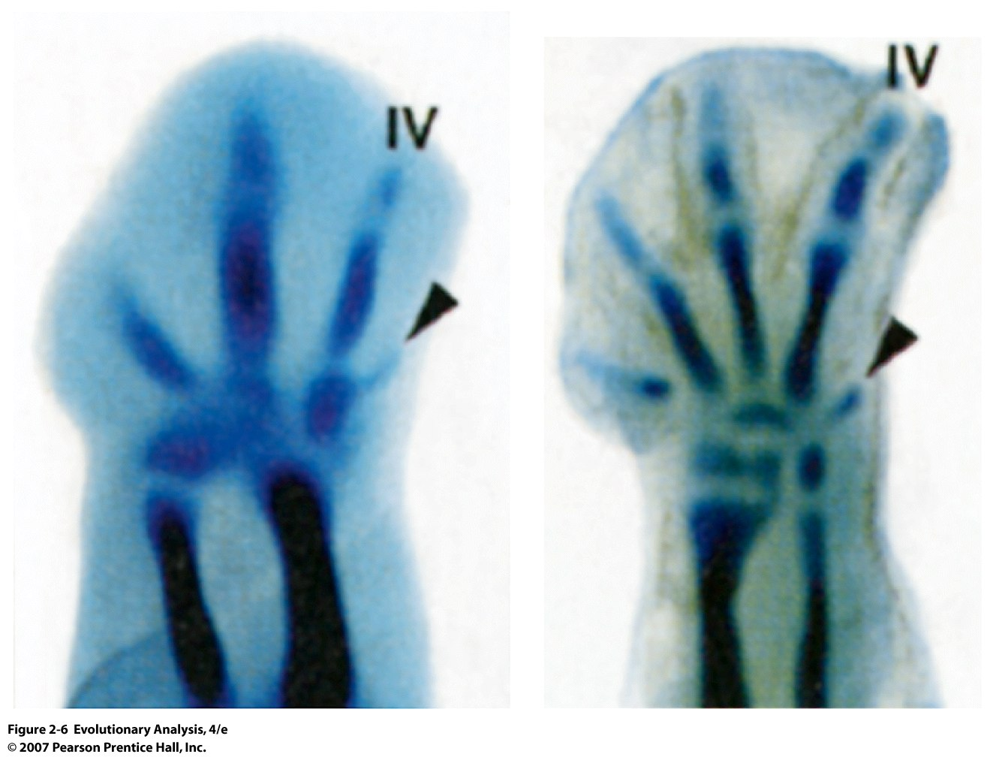
Chicken wings Chicken feet
Remnant digit
appears during
development
Notes:
Figure 2.6 Developmental vestigial traits
Adult chickens have three digits in their wings and four in their feet. But during development, an extra digit appears for a short time in the "hand" (top) and foot (bottom). From Burke and Feduccia (1997).

Slide 8
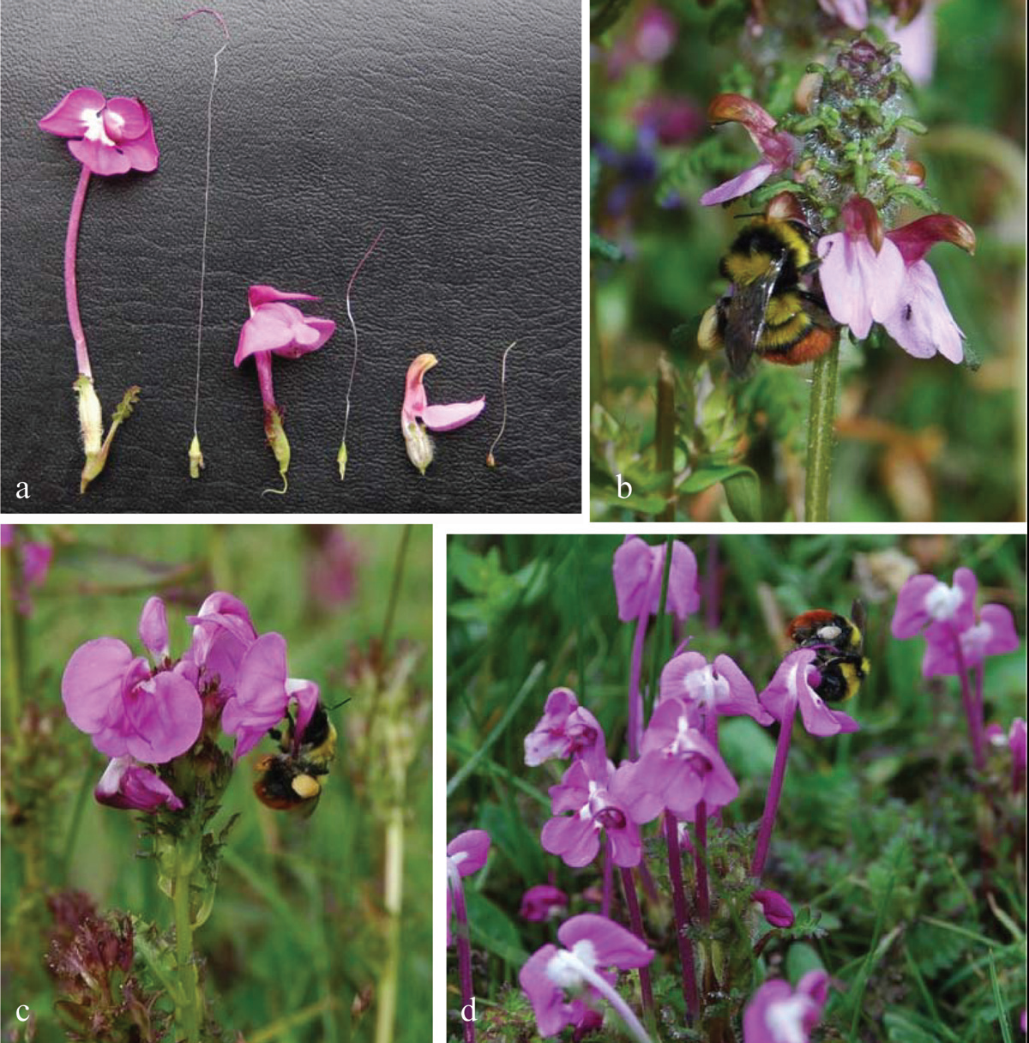
Three Pedicularis species from Tibet
Long tubed species
are nectarless
Huang and Fenster 2007

Slide 9
Fig. 3 Nectary SEM micrographs of three Pedicularis species. a, d, Pedicularis densispica. b, c, Pedicularis gruina. c, f, Pedicularis siphonantha. a–c, Views of ovary with the nectary (arrow) at its base, showing different sizes of nectary. Scale bars ¼ 100 mm. d–f, Detail of the nectary epidermis, showing different fullness of epidermis cells among three species. Scale bars ¼ 10 mm.

Slide 10
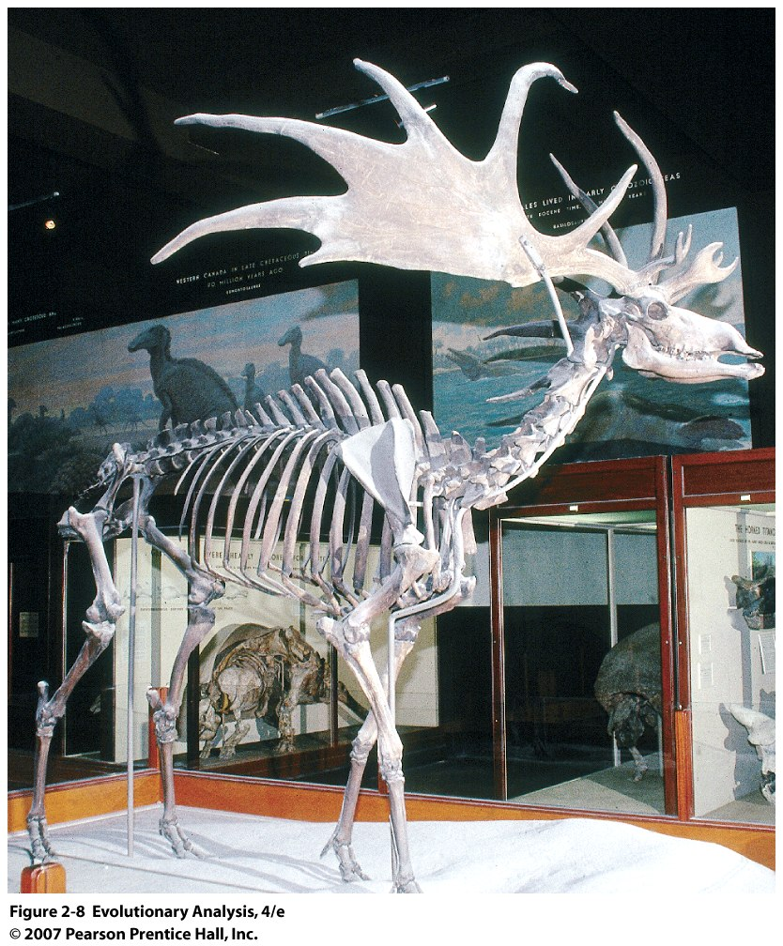
B. Extinction
Irish Elk
actually a deer
Notes:
Figure 2.8 The Irish elk confirms the fact of extinction
Cuvier confirmed that fossils of the huge ice-age deer called the Irish elk represented an extinct species. Prior to Cuvier fossils of extinct animals were thought to be present but undiscovered

Slide 11
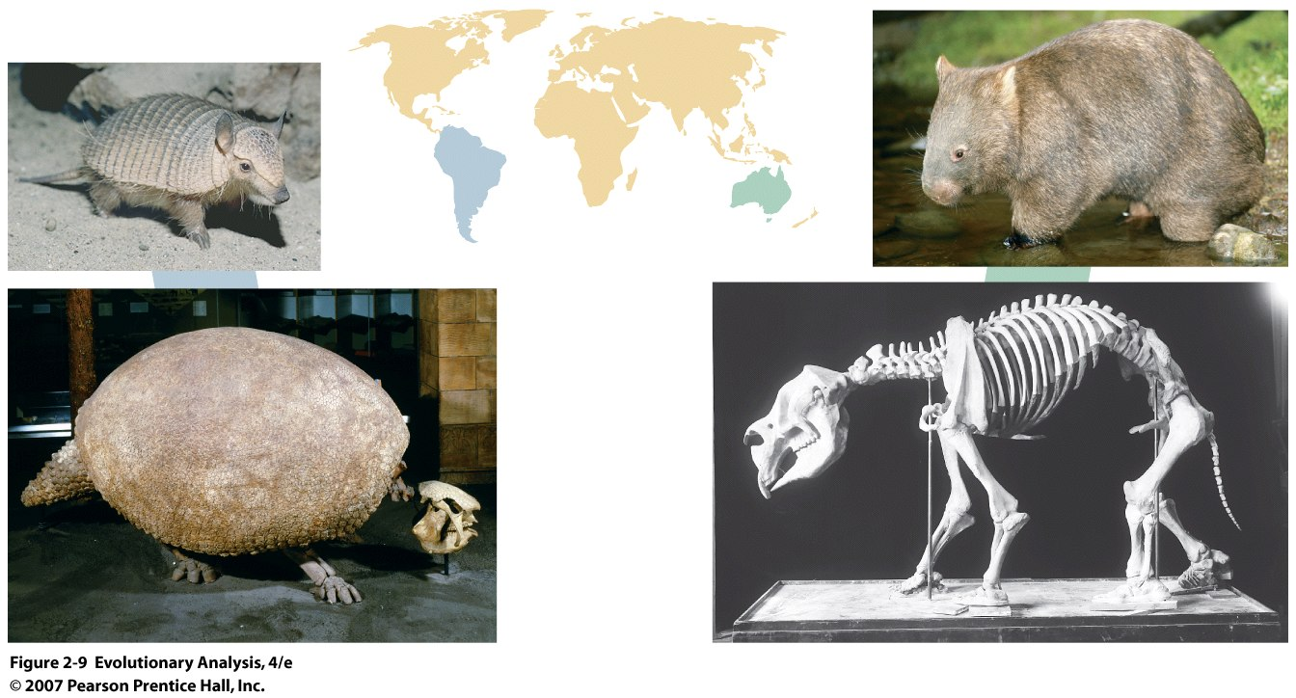
C. Law of Succession
Correspondence between fossil and living forms from the same locale
Fossil from Argentina Fossil from Australia
Armadillo Wombat
Notes:
Figure 2.9 The law of succession consistent with theory of evolution, species are derived from ancestral species.
Early researchers so routinely observed close relationships between fossil and extant species from the same geographical area and between fossil forms in adjacent rock strata that the pattern became known as the law of succession. Darwin noted the similarities between the contemporary pygmy armadillo (Zaedyus pichiy) (top left) and the fossil glyptodont (bottom left) of Argentina. Richard Owen confirmed a pattern first recognized by William Clift when Owen identified the extinct Australian mammal Diprotodon (lower right) as a marsupial similar to the wombats (upper right) that live in Australia today (Dugan 1980). Fauna of N. America today and recent fossils.

Slide 12
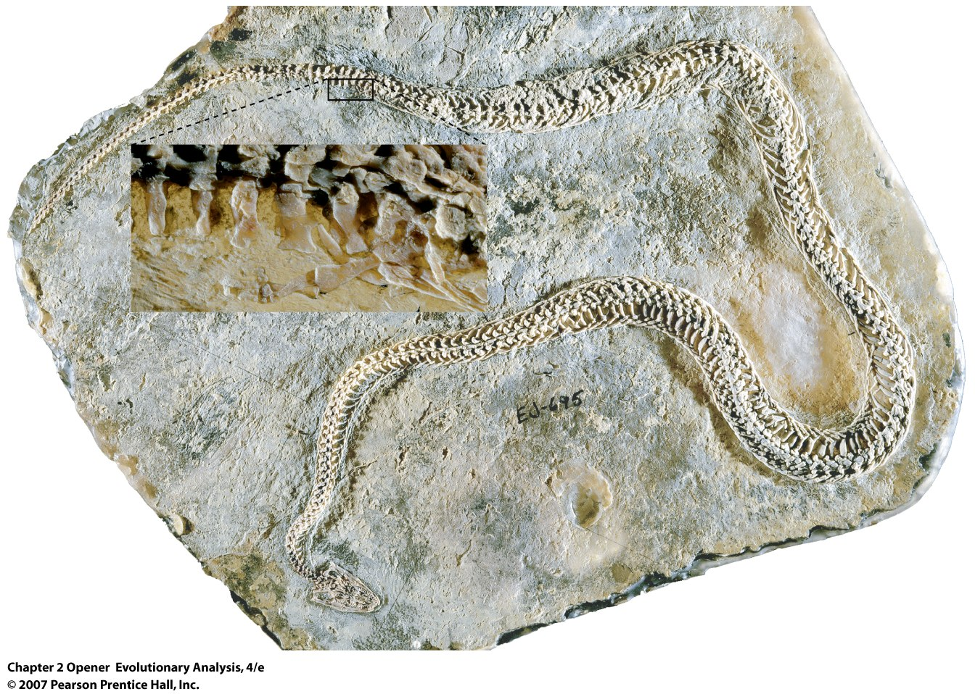
D. Transitional Forms
95 m y old fossil of snake with large
(relatively) large hind limbs
Notes:
Chapter 2 Opener A snake with legs.
This 95-million-year-old fossil snake has small but fully formed hind limbs. Called Haas's Holy Land snake (Haasiophis terrasanctus), it documents the previous existence of snakes leggier than any alive now. See Tchernov et al. (2000); Rieppel et al. (2003).
Not actually Transitional in the sense that this species connects one specific ancestor to a specific descendent or contemporary species, rather, the characters are such that they show a mixture of old and new.

Slide 13
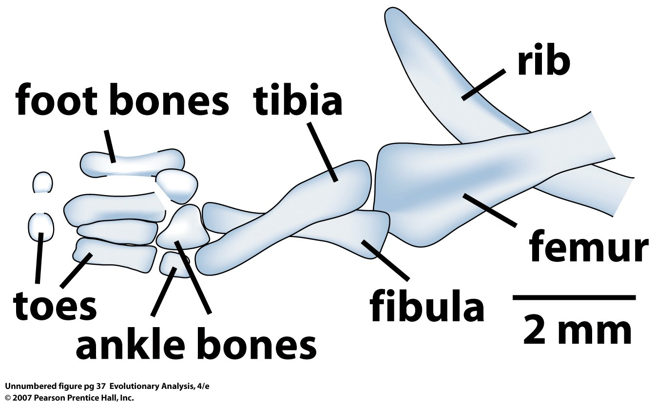
Notes:
Chapter 2 Opener A snake with legs.
This 95-million-year-old fossil snake has small but fully formed hind limbs. Called Haas's Holy Land snake (Haasiophis terrasanctus), it documents the previous existence of snakes leggier than any alive now. See Tchernov et al. (2000); Rieppel et al. (2003).

Slide 14
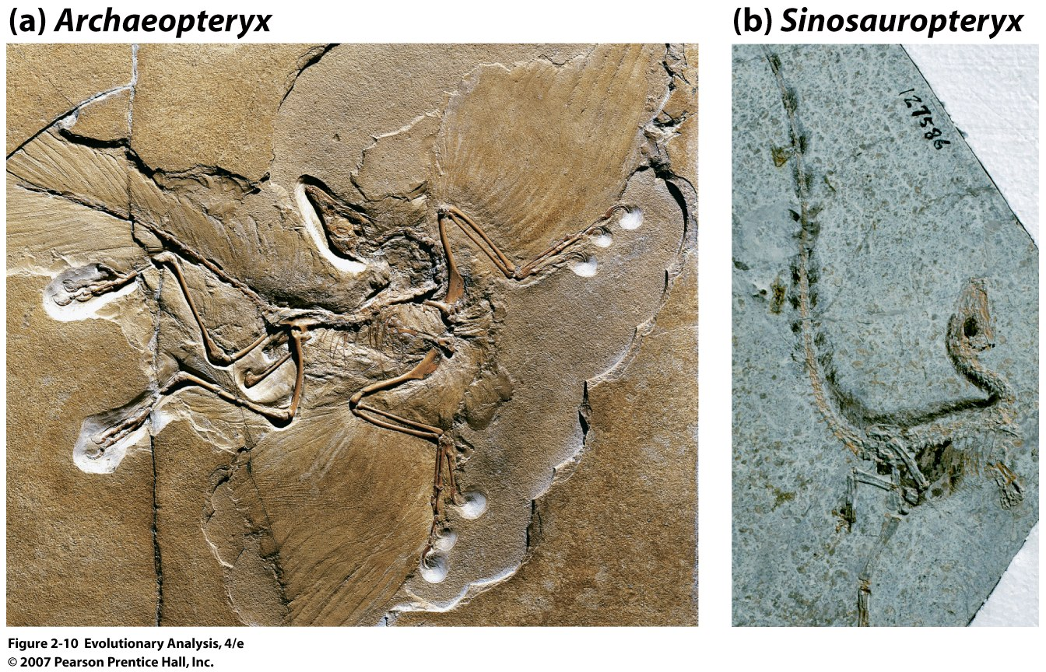
A bird with a dinosaur's skeleton and a dinosaur with feathers
Notes:
Figure 2.10 A bird with a dinosaur's skeleton and a dinosaur with feathers
Archaeopteryx, a bird with modern feathers and a dinosaur-like skeleton. (b) Sinosauropteryx prima, a dinosaur with bristly structures on its neck, back, flanks, and tail that many paleontologists believe are down-like feathers. From Chen et al. (1998).
Teeth and 3 toed hands, tail

Slide 15
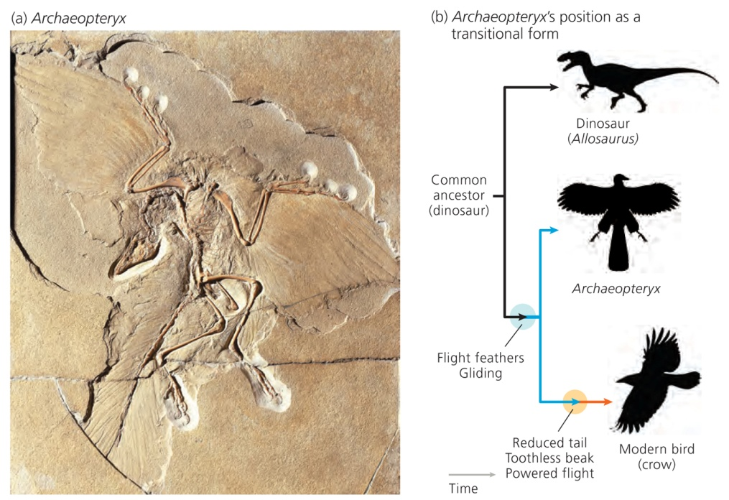
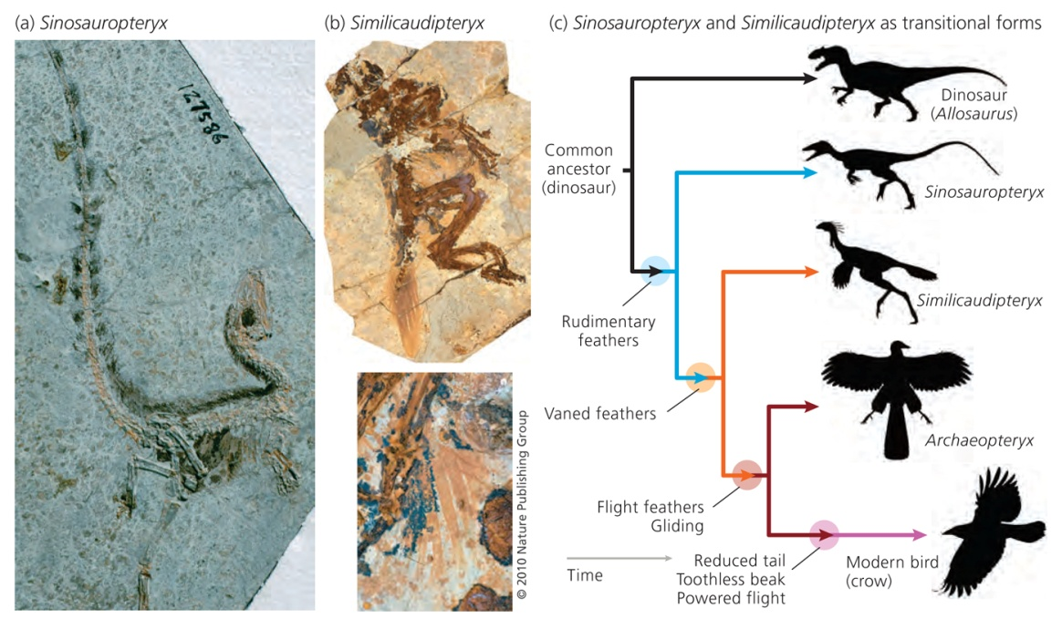

Slide 16
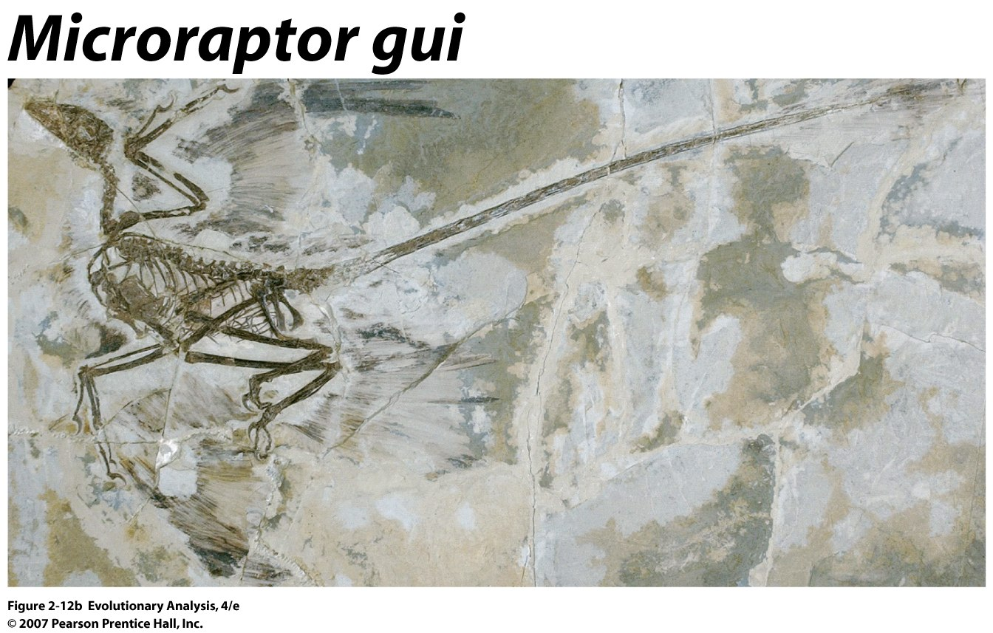
A dromaeosaur with flight feathers on all four limbs
Notes:
Figure 2.12b Dinosaur feathers
(b) Microraptor gui, a dromaeosaur with flight feathers on all four limbs—that is, a four-winged dinosaur. From Xu et al. (2003).

Slide 17
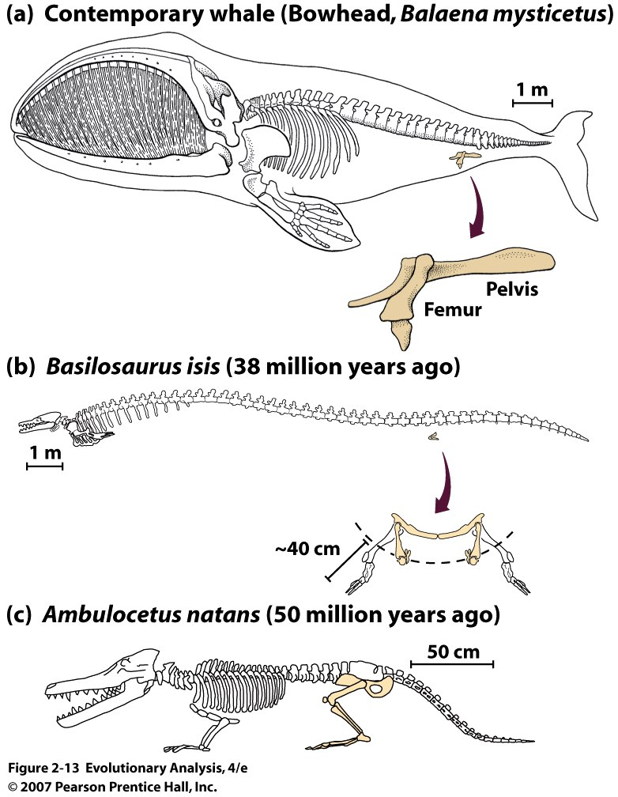
More Transitional Fossils
Notes:
Figure 2.13 Transitional fossils documenting the evolution of whales from leggy ancestors
(a) Some contemporary whales have a vestigial femur and pelvis. (b) Basilosaurus isis fossils are about 38 million years old. They have reduced hind limbs that probably did not function in swimming. Instead, the legs may have been used as a grasping structure during copulation. From Gingerich et al. (1990). (c) Ambulocetus natans (literally translated, means "walk-whale swimming") fossils are about 50 million years old. They have functional hind limbs that were probably used as paddles in swimming. From Thewissen et al. (1994).

Slide 18
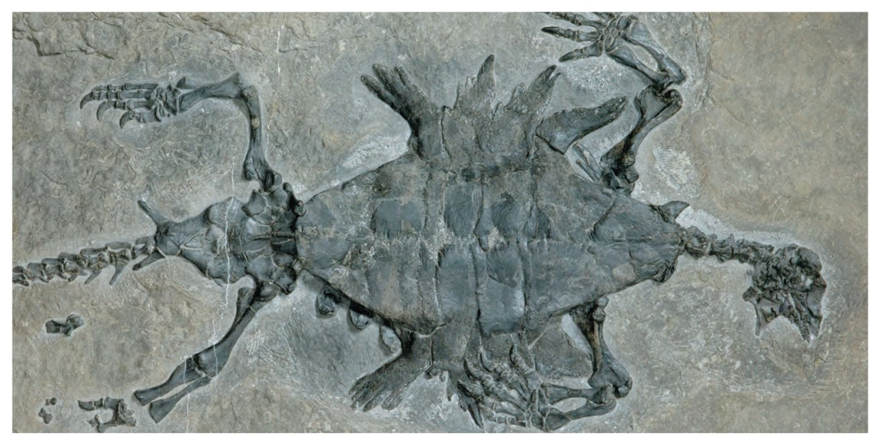
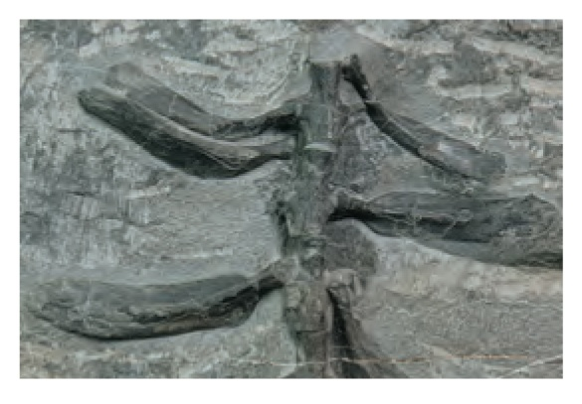
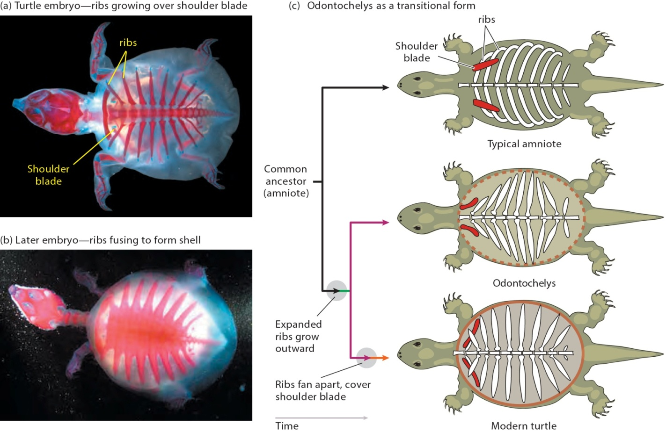

Slide 19
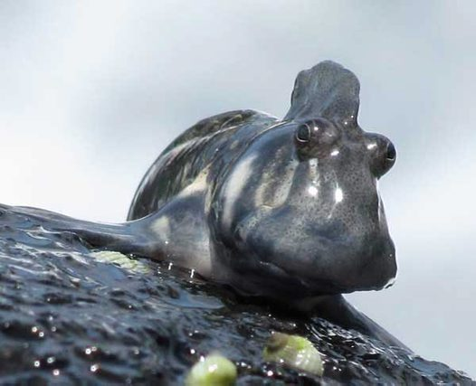
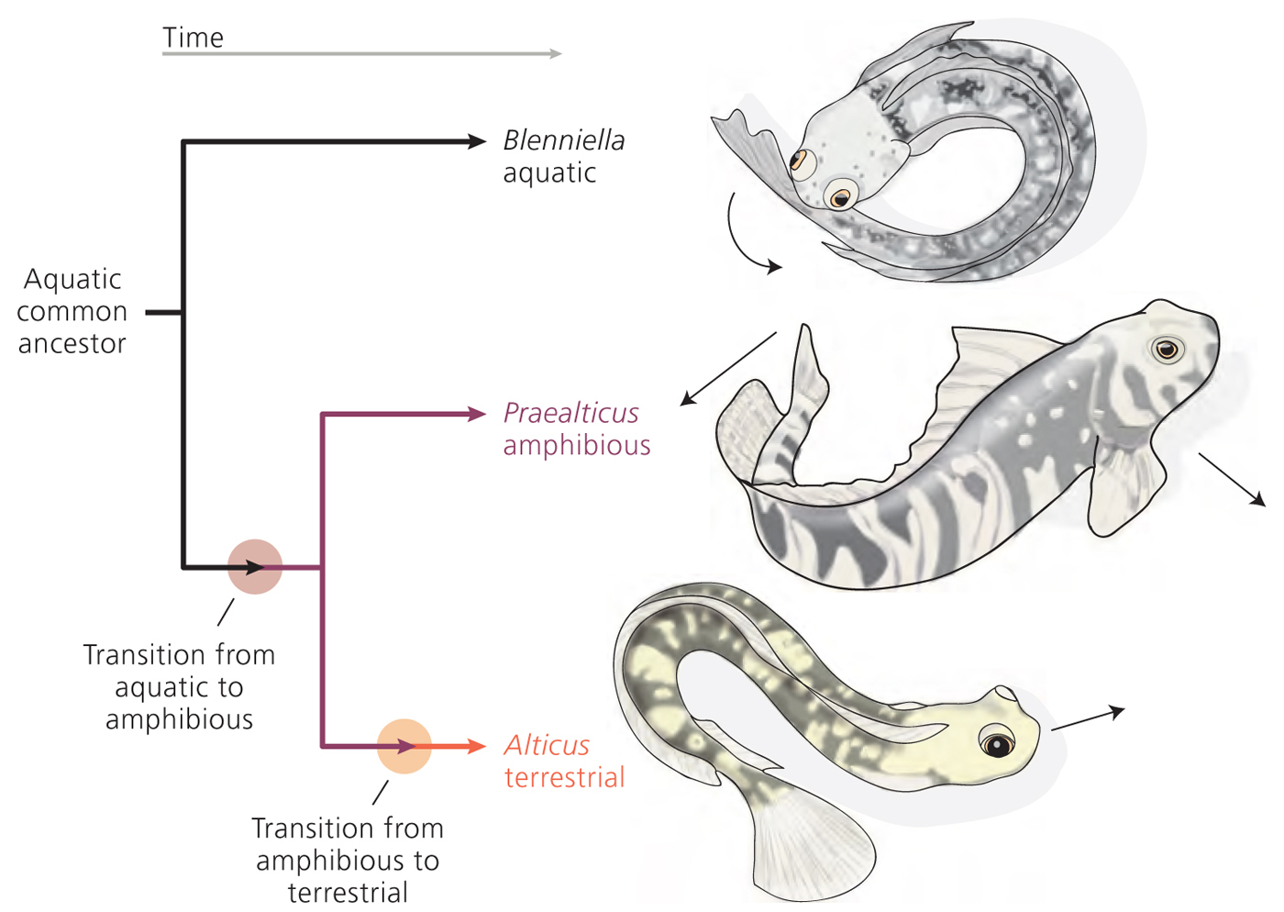
Indian Ocean Blenny
A male Indian Ocean amphibious
blenny, Alticus monochrus,
at Albion, Mauritius
Notes:
Derived traits

Slide 20
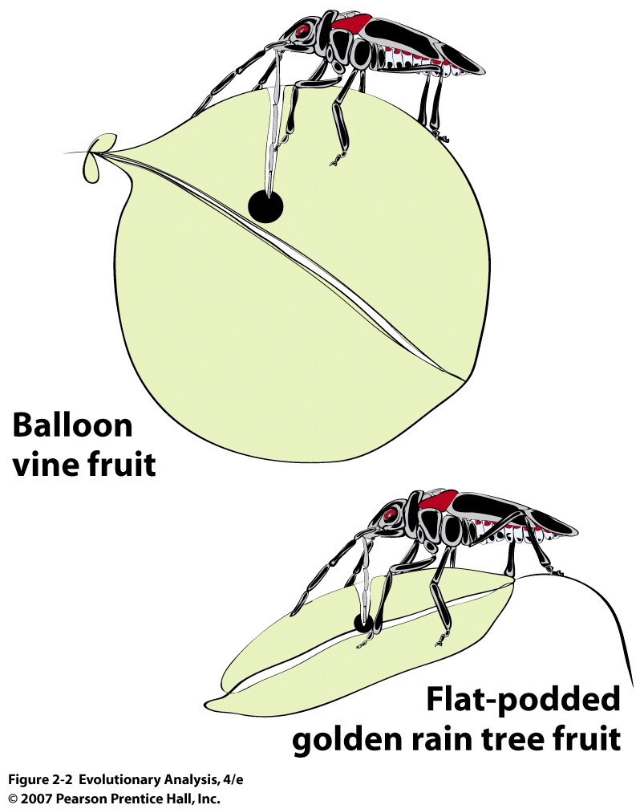
E. Evidence of recent evolution
Soapberry bugs
Native to florida
Introduced from Asia
Notes:
Figure 2.2 Soapberry bugs
After Fig. 1 in Carroll and Boyd (1992).

Slide 21
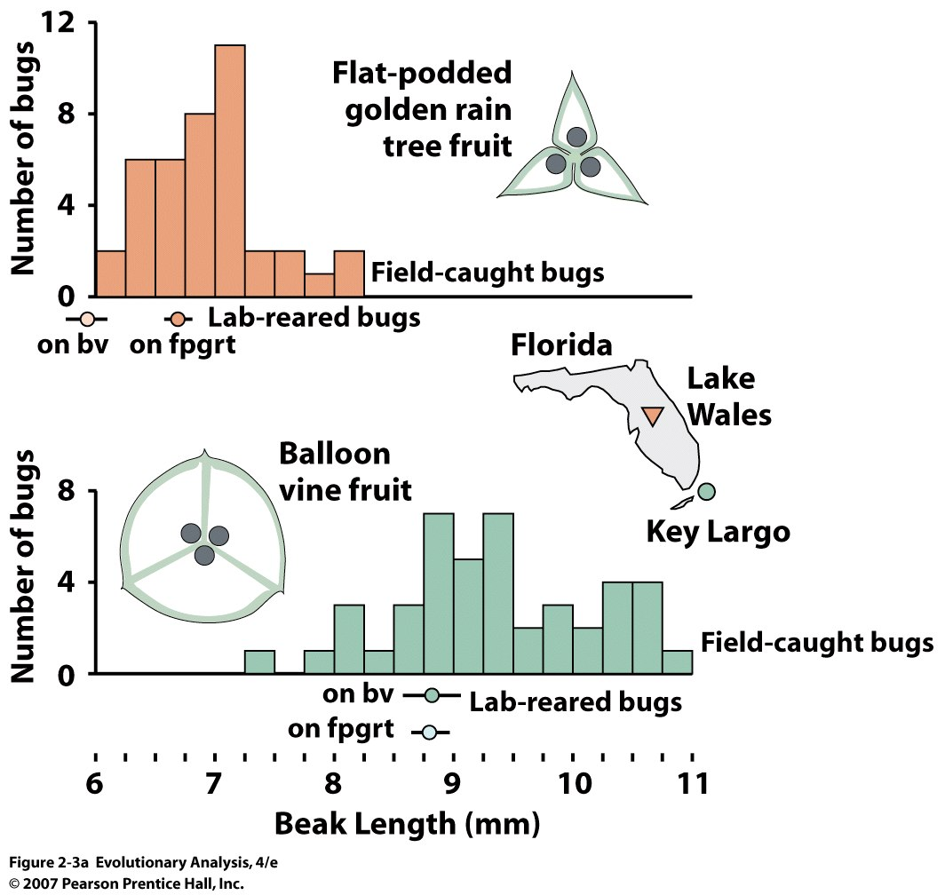
INTRODUCED
NATIVE
Notes:
Evolution uniformatism Figure 2.3a Evolutionary change in soapberry bugs
(a) The bar graphs show that the soapberry bugs found in nature on flat-podded golden rain trees have, on average, shorter beaks than bugs found on balloon vines. The balloon vine is native to southern Florida, while the flat-podded golden rain tree was introduced in the late 1920s from Asia. The data points below the horixontal axes show the mean beak length (±standard error) of bugs reared in the lab on fruits from balloon vine (bv) versus flat-podded golden rain tree (fpgrt).

Slide 22
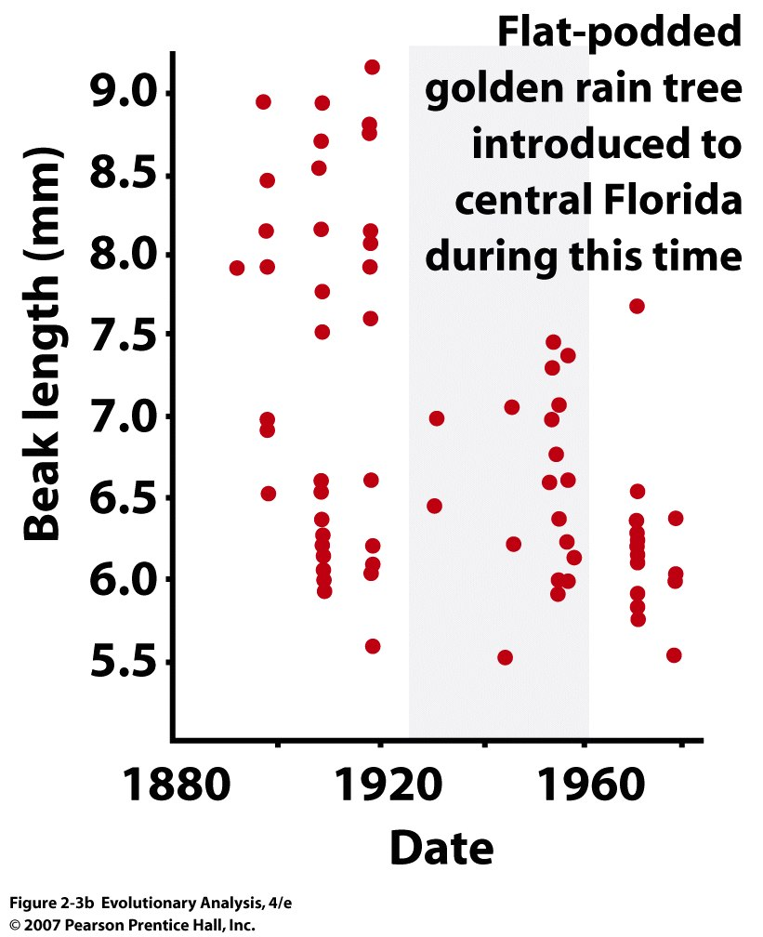
Notes:
Figure 2.3b Evolutionary change in soapberry bugs
(b) The scatterplot shows the beak lengths of female soapberry bugs from Florida in museum collections (each data point represents one individual). See text for explanation. Rendered from Figs. 3, 4, and 6 in Carroll and Boyd (1992) and Fig. 3 in Carroll et al. (1997).

Slide 23
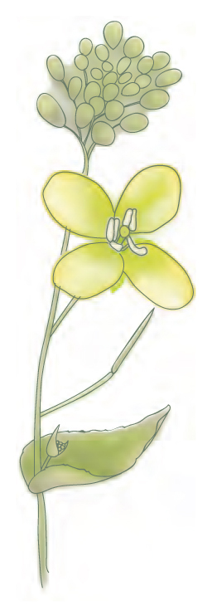
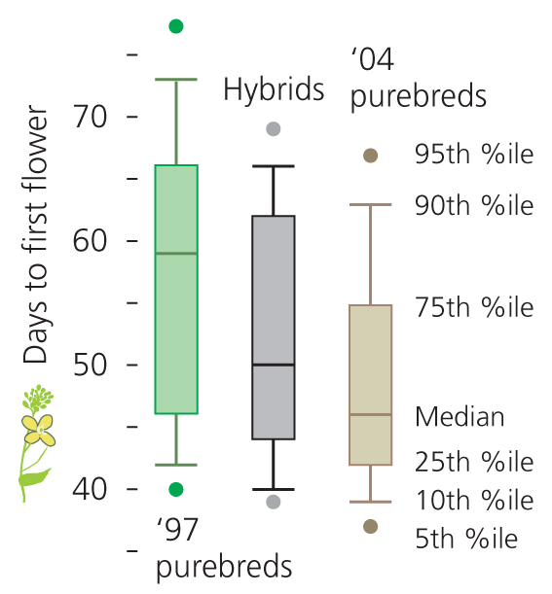
Figure 2-5

Slide 24
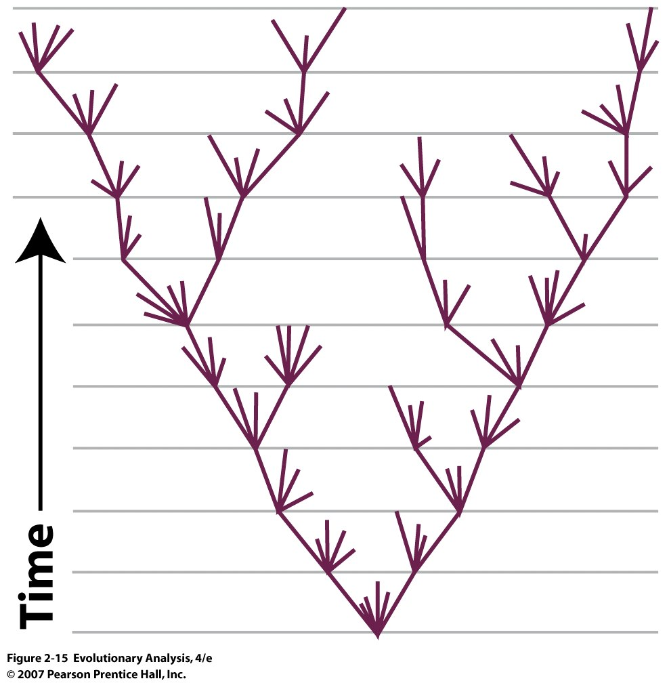
IV. Evidence of Common Ancestry
Tree Building and Phylogenies:
Common Ancestry Implies two species sharing a common ancestor, and
should be able to reconstruct with a tree or phylogeny of life
Extinct lineage
Notes:
Figure 2.15 Darwin's evolutionary tree
The root of this tree is at the bottom, so we read the history it records from bottom to top. Only illustration in Darwin’s on the origin of species Note some lineages go extinct

Slide 25
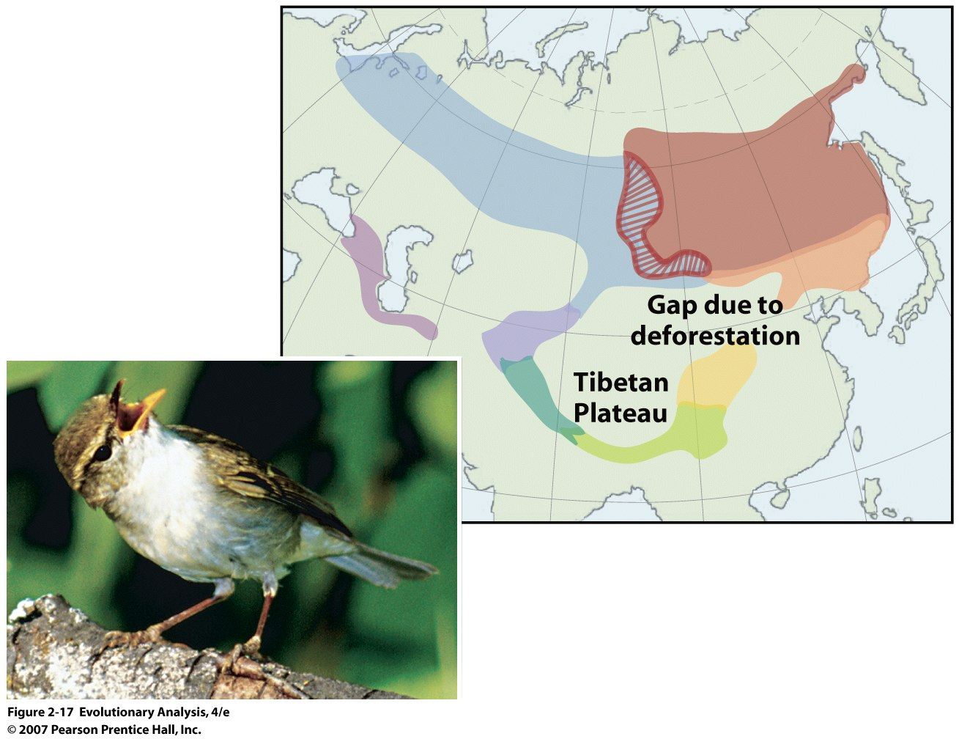
B. Species can split into
two
Siberian greenish warbler
Notes:
Figure 2.17 Evidence that one species can split into two
Left, a Siberian greenish warbler (Phylloscopus trochiloides). Right, a map showing the ranges of the greenish warbler's geographic variants. The birds interbreed everywhere they meet around the Tibetan Plateau, except where the northwestern form meets the northeastern form in the region indicated by hash marks. There, the birds behave as different species. Photo by D. Irwin, from Wake (2001); map from Irwin et al. (2005).

Slide 26
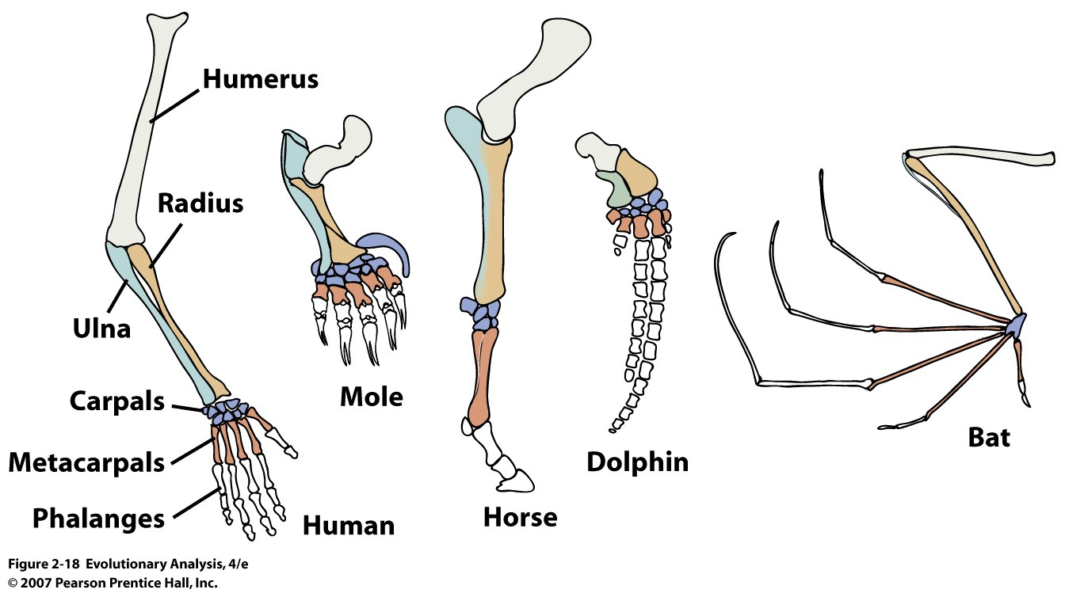
C. Homology:
Similarity between species resulting from inheritance of traits from a common
ancestor
Different function but similar construction
Notes:
Homology: Study of likeness. Traits in different species are similar because of descent from common ancestor
Figure 2.18 Structural homologies
These vertebrate forelimbs are used for different functions, but have the same sequence and arrangement of bones. In this illustration, homologous bones are colored in the same way and are labeled on the human arm.
Same genes involved in limb elongation across animals
Basis for model organism for medical research

Slide 27
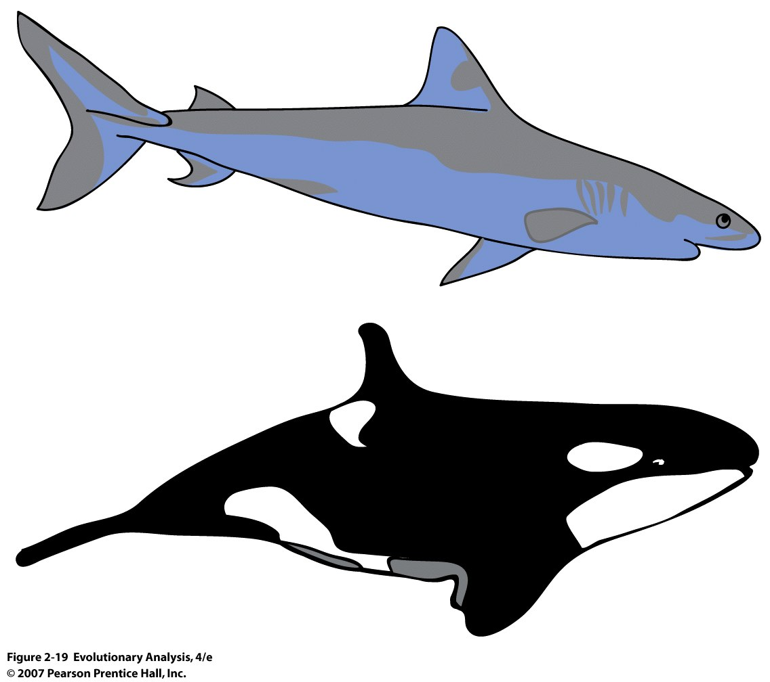
Nonhomologous similarities
fins
hands
Notes:
Figure 2.19 Nonhomologous similarities
This shark and Orca both have streamlined shapes, powerful tails, and short fins or flippers, even though one is a fish and the other a mammal. These similarities all make sense in light of their function and are not homologous.

Slide 28
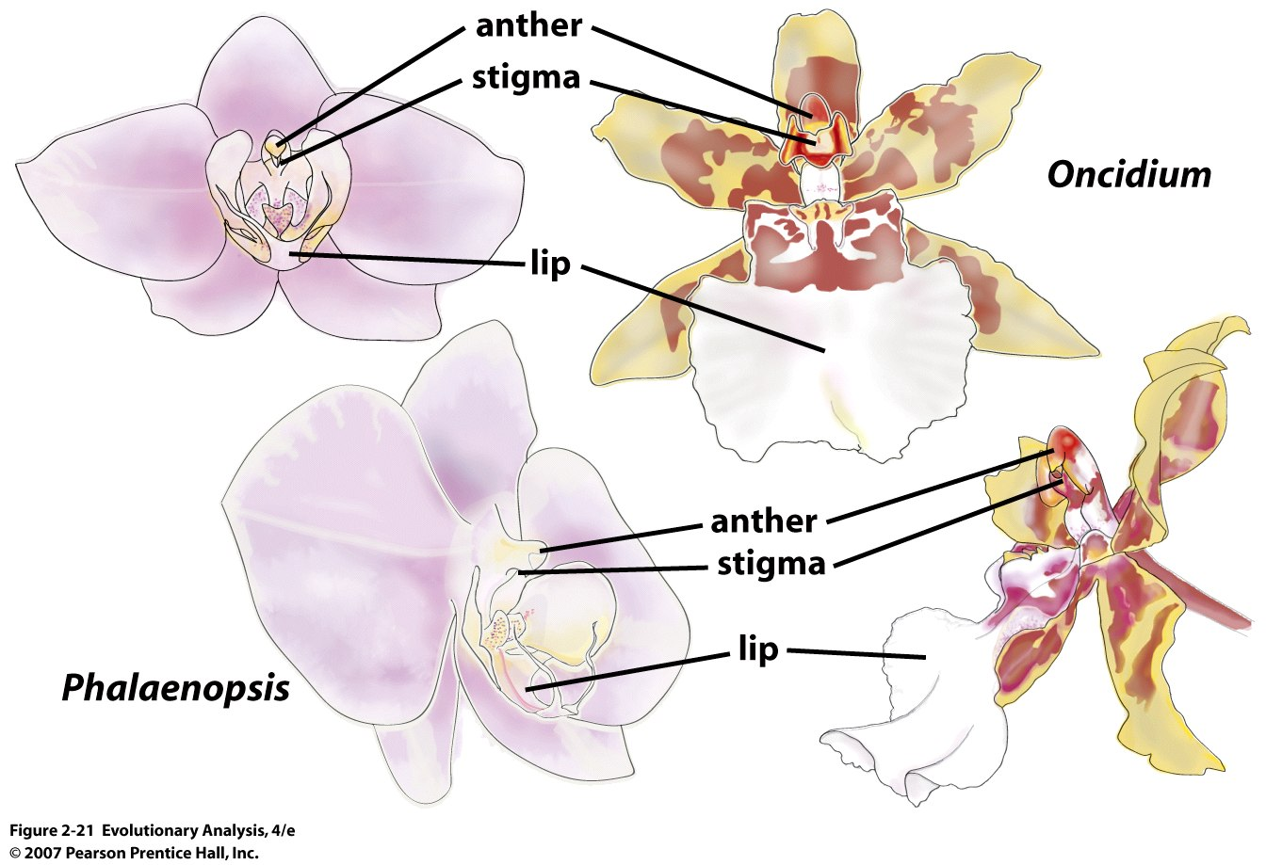
Notes:
Figure 2.21 More structural homologies Monocot 3 sepals and 3 petals = tepal
Orchid flowers are diverse in size and shape, but are comprised of elements that are similar in structure and orientation. From Darwin (1862).

Slide 29
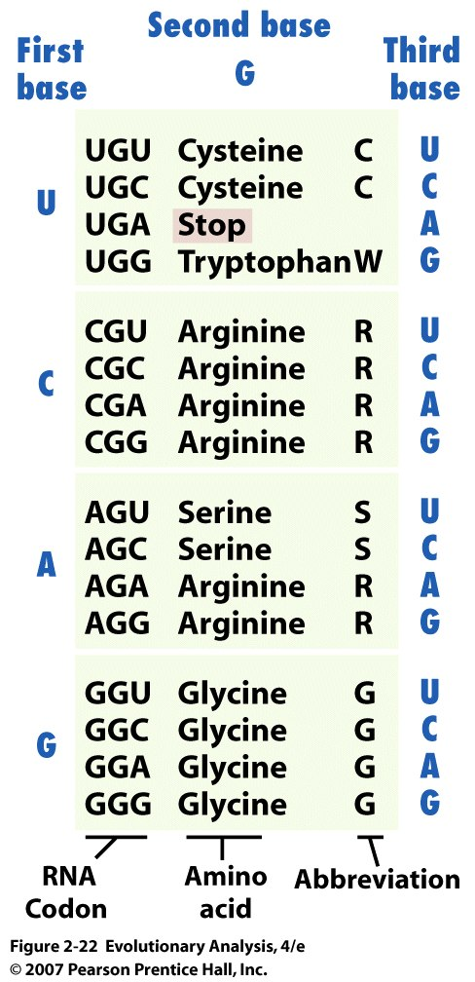
Notes:
Figure 2.22 A genetic homology: the genetic code
In almost every organism, the same nucleotide triplets, or codons, specify the same amino acids to be incorporated into proteins. This chart shows a portion of the code. The entire code appears in Chapter 5, Figure 5.3.

Slide 30
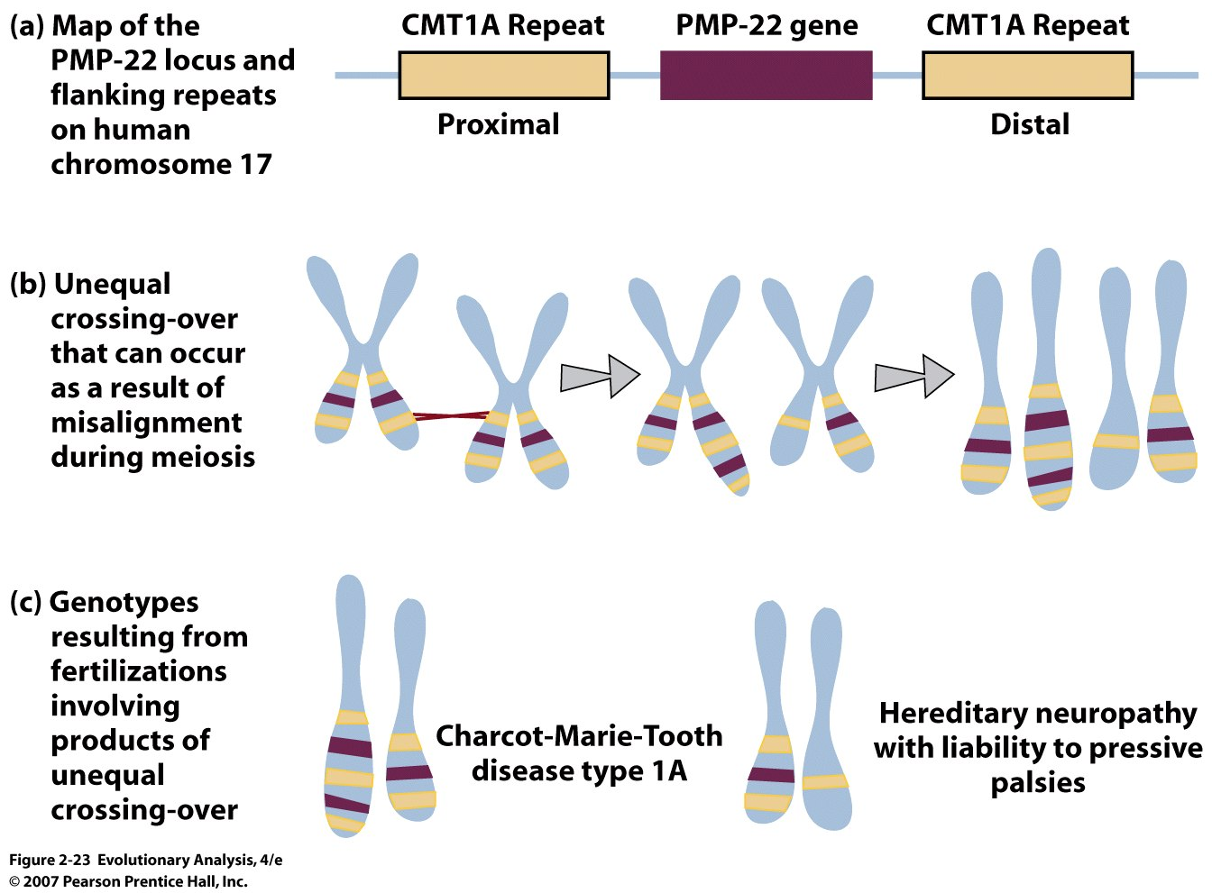
Genetic Flaws reveal shared ancestry:
Human-Chimp shared genetic flaws
Part of protein coded
by COX10
Notes:
Figure 2.23 A genetic flaw that humans share with chimpanzees, proximal repeat not found in gorillas etc.
The proximal CMT1A repeat, near the gene for PMP-22, is a duplication of the distal repeat on the other side of the gene. (b) The proximal repeat can align with the distal repeat during meiosis, resulting in unequal crossing-over. (c) The genotypes that result from the unequal crossing-over are associated with neurological disorders.
http://ghr.nlm.nih.gov/gene/PMP22
repeats drawn on board

Slide 31
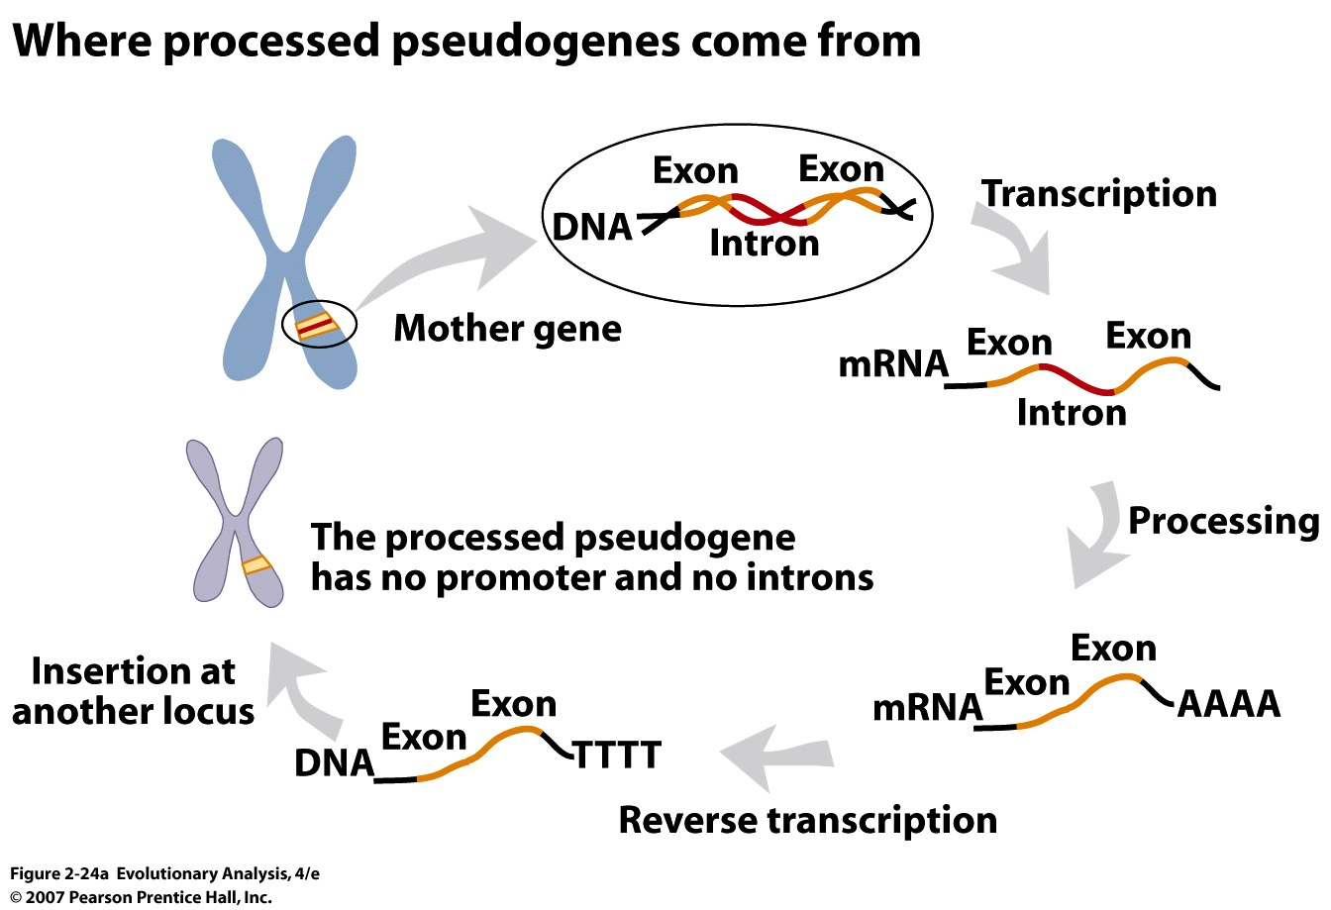
Notes:
Figure 2.24a Processed pseudogenes used to test Darwin's hypothesis of common ancestry
Processed pseudogenes arise when processed messenger RNAs are reverse transcribed and inserted into the genome; biologists can estimate their age by the number of mutations they have accumulated.
Telomerase adds DNA at the 3' end at the end of our chromosomes (telomere area), and uses RNA as a template for elongation = reverse transcriptase in nearly all euKaryotes

Slide 32
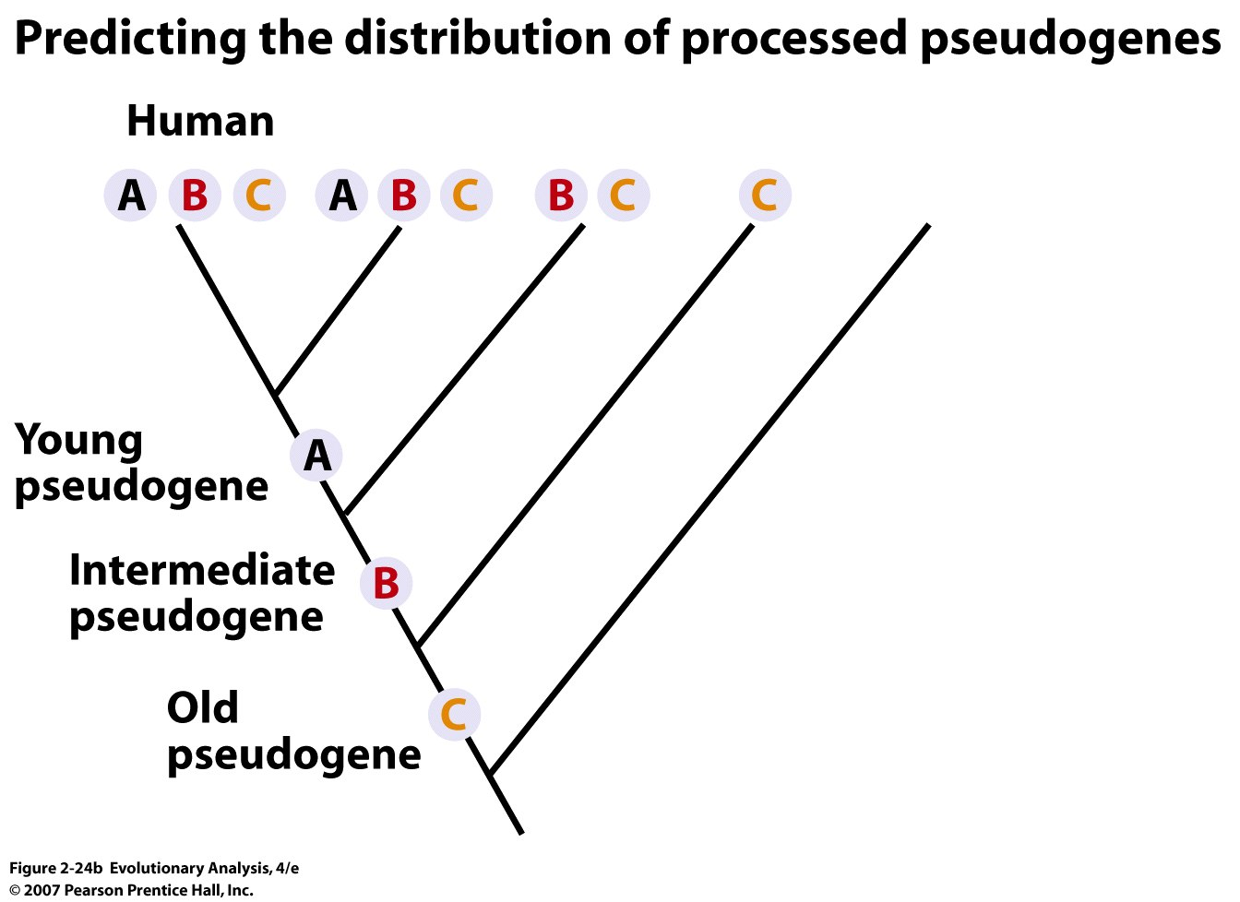
Notes:
Figure 2.24b Processed pseudogenes used to test Darwin's hypothesis of common ancestry
(b) If Darwin's hypothesis of common ancestry is correct, then older, processed pseudogenes should occur in a broader range of species.

Slide 33
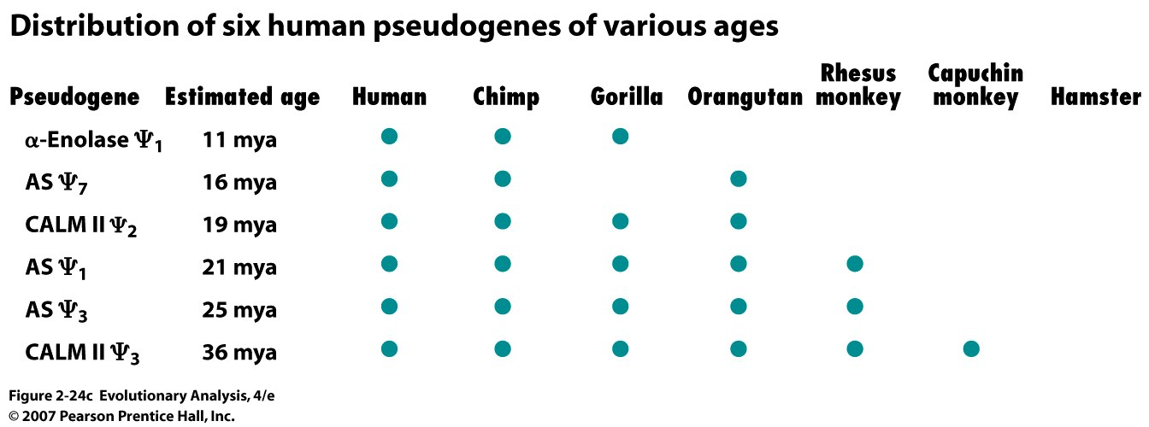
Notes:
Figure 2.24c Processed pseudogenes used to test Darwin's hypothesis of common ancestry
(c) The taxonomic distributions of these six processed pseudogenes are consistent with this prediction.

Slide 34
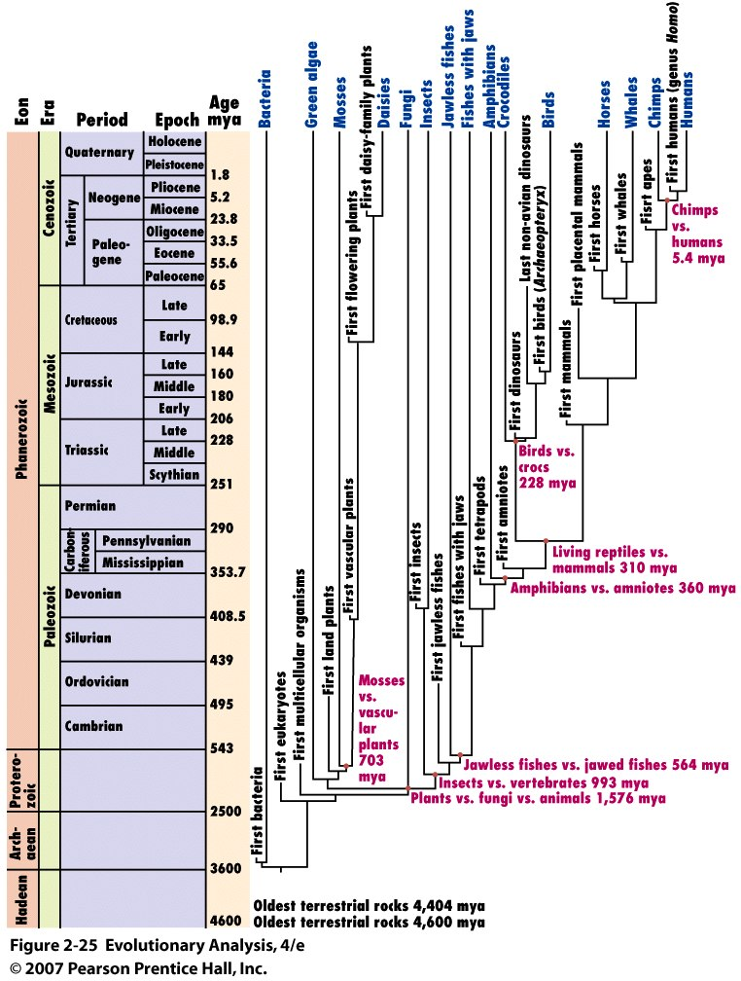
V. Timing
A. Evolution occurs
over long time
periods
Notes:
Figure 2.25 The geologic time scale
The sequence of eons, eras, periods, and epochs shown on the left part of this diagram was established through the techniques of relative dating. Each named interval of time is associated with a distinctive fossil flora and fauna. The absolute ages included here were added much later, when radiometric dating systems became available. The abbreviation mya stands for millions of years ago. The evolutionary tree on the right includes some important fossils (in black) and a few familiar extant organisms (in green). See Hedges (2002) for a detailed overview of the tree of life. The divergence times marked by red dots are estimates based on genetic data (Hedges and Kumar 2003).
Principle of superposition
Principle of Horizontality
Principle of cross-cutting relationships
Principle of inclusions
Principle of faunal successions

Slide 35
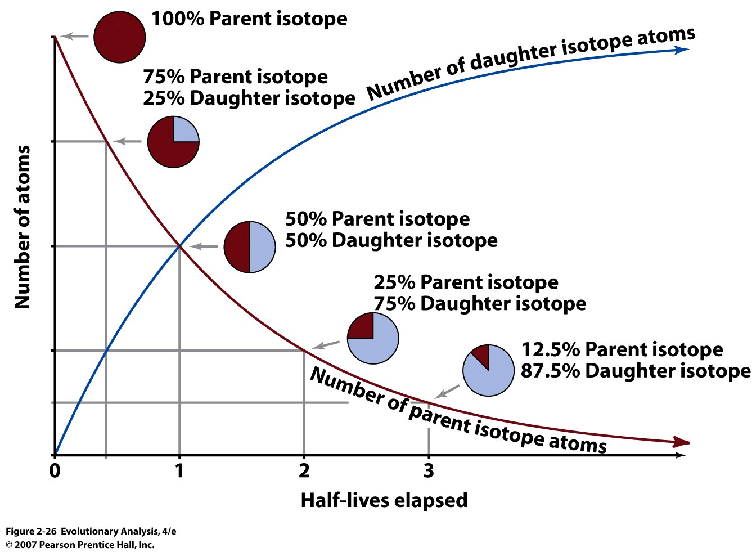
Notes:
Figure 2.26 Radioactive decay
Many radioactive isotopes decay through a series of intermediates until a stable daughter isotope is produced. Researchers measure the ratio of parent isotope to daughter isotope in a rock sample, then use a graph like this to convert the measured ratio to the number of half-lives elapsed. Multiplying the number of half-lives that have passed by the number of years it takes for a half-life to elapse yields an estimate for the absolute age of the rock.

Slide 36
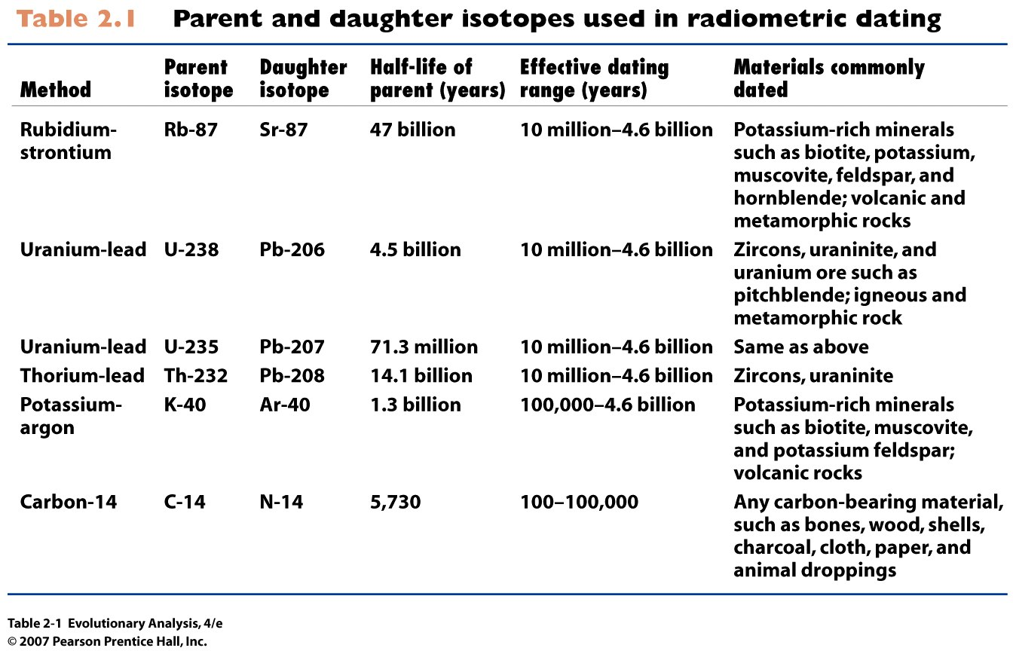
Notes:
Table 2.1 Parent and daughter isotopes used in radiometric dating

Slide 37
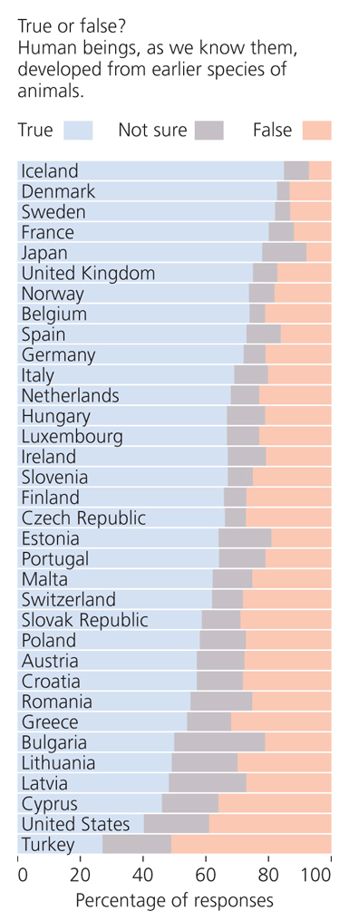
VI. Religious Essence of Intelligent Design
(Forrest in Evolution The Molecular Landscape, Cold Spring Harbor Laboratory Press, 2009, this slide and the next with the quote from Phillip Johnson)
Not a single expert witness over the course of the six week trial identified one major scientific association society or organization that endorsed ID as science….We have concluded that it is not [science], and moreover that ID cannot uncouple itself from its creationist, and thus religious antecedents (Jones 2005)

Slide 38
Phillip Johnson, major proponent of ID in an interview:
I also don’t think that there is really a theory of intelligent design at the present time to propose as a comparable alternative to the Darwinian theory, which is, whatever errors it might contain, a fully worked out scheme. There is no intelligent design theory that comparable. Working our a positive theory is the job of the scientific people that we have affiliated with the movement. Some of them are quite convinced that it’s doable ,but that’s for them to prove….No product is ready for competition in the education world.

Slide 39
The grand ami of all science is to cover the greatest number of empirical facts by logical deduction from smallest number of hypotheses or axioms (Albert Einstein)
What is a Theory?
Hierarchical framework that contains clearly formulated postulates based on a minimal set of assumptions from which a set of predictions logically follows.
Theory from theoria (Greek) = viewing or contemplation. In use, a way of looking at the world.

Slide 41
Much effort to educate public
Science and faith does not conflict
Public and private initiatives

Slide 42
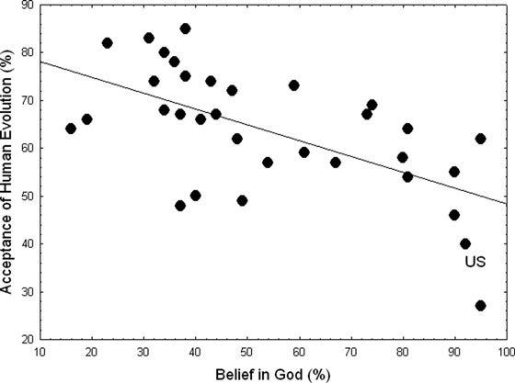
US resistance to Evolution
Coyne, 2012, Evolution

Slide 43
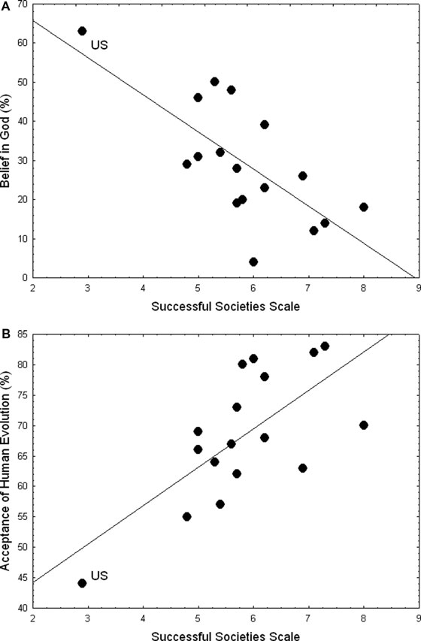

Slide 44
Conclusion, Evidence for Evolution
Descent with modification
Vestigial traits
Darwin’s Law of Succession
Transitional forms in fossil record
Common Ancestry
Phylogenies
Homology
Extinction
Recent evolution
Age of Earth
Science uses natural phenomenon to describe the world. Supernatural explanations do not belong in science classes.

